Slide 1

2019 ZICA AGM
IFRS Updates
Andrew Chibuye
May 2019
READ & DELETE BEFORE USING
If replacing the pattern/photo on this slide, first, click on and delete the pattern/photo. Then, click on the icon in the placeholder to select a new image. Size and crop if/as needed. Final image is 7.5”/190.5mm tall x 7.5”/190.5mm wide. Use images from our library.

Slide 2
Agenda
The IFRS landscape
Year 2 considerations
  IFRS 9: Financial Instruments
  IFRS 15: Revenue from contracts with customers
IFRS 16: Leases
Questions

Slide 3
The IFRS landscape
1

Slide 4
Amendments
Effective 1 January 2019
IFRS 3
IFRIC 23
Definition of a business
  INPUTS + PROCESS = OUTPUT
  Outputs now focusses on goods and services
  More asset acquisitions than business combinations
Uncertain tax positions
  Previously clarified: IAS 12 vs IAS 37
  Deals with timing and measurement

Slide 5
IFRS timeline
A seismic shift in significant standards
02
al framework
IFRS 9
2018
counting limitations
IFRS 15
2018
IFRS 16
2019
IFRS 17
2021

Slide 6
IFRS 9: Financial Instruments
2

Slide 7

IFRS 9
Change in credit quality since initial recognition
Stage 1
Stage 2
Stage 3
_{Performing}
_{(Initial recognition)}
Underperforming
(SICR since initial recognition)
Non-performing
(Credit impaired assets)
Recognition of ECL
12 month ECL
Lifetime ECL
Lifetime ECL
Interest revenue
Effective interest on gross carrying amount
Effective interest on gross carrying amount
Effective interest on amortised cost carrying amount
(i.e. net of credit allowance)

Slide 8
Significant increase in credit risk
Changes in business
Changes in external market indicators
Changes in internal price indicators
Other qualitative inputs
Changes in credit ratings
Changes in operating results
30 days past due
  However….

Slide 9
Trade receivables
Trade receivables with no significant financing component
Simplified approach: ECL
Lifetime ECL

Slide 10
Survey findings: Banks and NBFIs
Commercial banks
NBFIs
Implementation of IFRS 9
Skills
Model build
Reduction
15%
Fwd looking info
Reduction
6%
BAU review
Data
Complexity
SICR
Stake-holders
Cost
Up >30%
36%
Up >30%
25%
15% of NBFIs yet to conclude assessment !!!

Slide 11
Survey findings: Banks and NBFIs
Implementation of IFRS 9: Expected benefits
Improved receivables book
Predictive value
Loan quality
Forward looking
Collaboration
Pricing
BPR
Inter-departmental collaboration
Improved pricing decisions
Review of processes
January 2019

Slide 12
2019 considerations
Government arrears
Implementation of IFRS 9: What next?
Government always pays!
IFRS 9 30 day back stop
Back test
Refine
Train
Automate
Bonds and bills??
Similar to region!!!

Slide 13
Tax deductibility
Remains a
significant
issue

Slide 14
IFRS 15: Revenues from contracts with customers
2

Slide 15
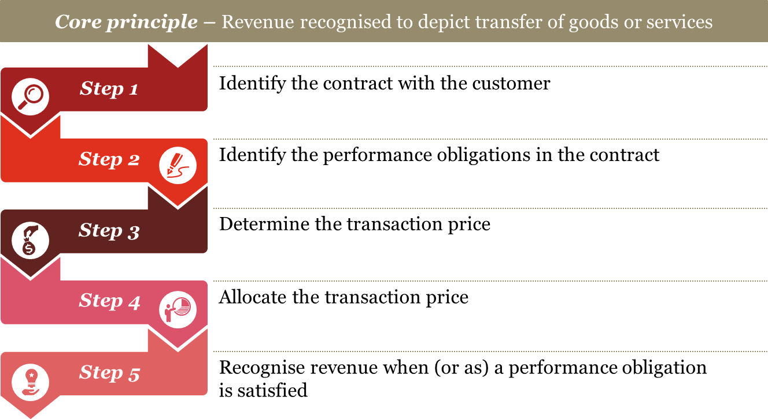
IFRS 15
IFRS 15 - Revenue

Slide 16
Focus on control…
Right to payment for asset
Customer has accepted the asset
Legal title to asset
Physical possession of asset
Customer has significant risk and rewards

Slide 17
Applying IFRS 15
Principal v Agent
Multiple elements
Acquisition costs
Licensing
Disclosure

Slide 18
IFRS 16: Leases
3

Slide 19


IFRS 16 background
“One of my great ambitions before I die is to fly in an aircraft that is on an airline’s balance sheet.”
Sir David Tweedie Chairman of the IASB (25 April 2008)
$1.25 tn
“non-cancellable future cash obligations committed under operating leases …. are not recognized on issuer balance sheets…”
Sec 2005

Slide 20
IFRS 16
Lessee has to present interest expense (on lease liability) and depreciation charge (for right-of-use asset) separately
Lessee has to recognise a right-of-use asset and a lease liability for almost all lease contracts
Huge impact on KPI (debt/equity ratio; EBIT/EBITDA/ operating cash flow)
Exemptions for short-term leases and leases of low value assets
Lessor accounting stays almost the same as under current guidance
Enhanced disclosure requirements
Effective date
1 January 2019
IFRS 16 was published on
13 January 2016
Earlier application permitted (together with IFRS 15)

Slide 21
IFRS 16 impact

Slide 22
Have you
done your
IFRS 16 impact
assessment?

Slide 23
Questions?

Slide 24
Thank you
© 2019 PwC. All rights reserved. Not for further distribution without the permission of PwC. “PwC” refers to the network of member firms of PricewaterhouseCoopers International Limited (PwCIL), or, as the context requires, individual member firms of the PwC network. Each member firm is a separate legal entity and does not act as agent of PwCIL or any other member firm. PwCIL does not provide any services to clients. PwCIL is not responsible or liable for the acts or omissions of any of its member firms nor can it control the exercise of their professional judgment or bind them in any way. No member firm is responsible or liable for the acts or omissions of any other member firm nor can it control the exercise of another member firm’s professional judgment or bind another member firm or PwCIL in any way.

