Slide 1
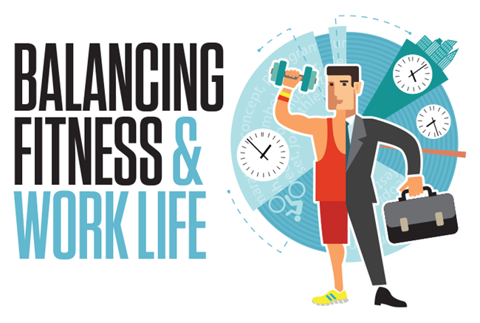
HEALTH AND FITNESS TALK
FOR ACCOUNTANTS
PRESENTED BY
COACH CHANDY

Slide 2
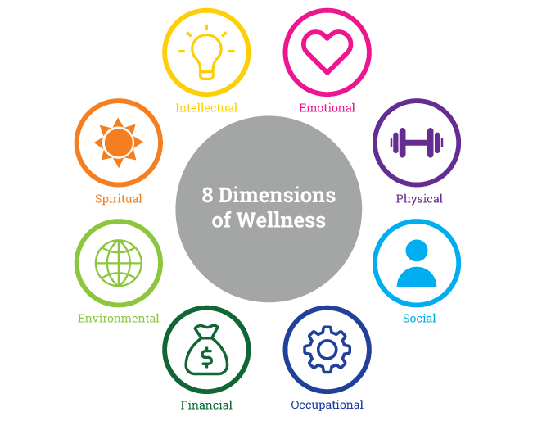

Slide 3
WHEN YOU HEAR THE WORD
‘FITNESS’
WHAT COMES TO MIND?
Notes:
That’s what we are here to talk about today. When you hear the word fitness what comes to mind?

Slide 4
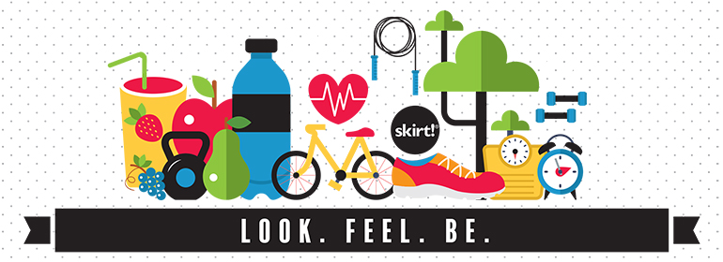
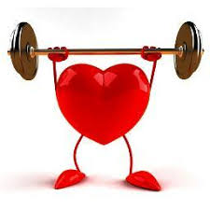
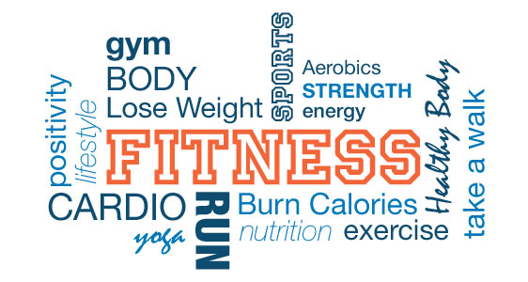
n

Slide 5
NCD – NON COMMUNICABLE DISEASES
CDs – COMMUNICABLE DISEASES
Notes:
NCD – NON COMMUNICABLE DISEASES
CDs – COMMUNICABLE DISEASES

Slide 6
I RUN, THAT MEANS I’M FIT RIGHT?
Our body is complex and if it is to be used efficiently it must be understood
Running is a great cardio activity but it will not deliver optimum health or fitness levels by itself (even if you have a perfect diet).

Slide 7
6 COMPONENTS OF PHYSICAL FITNESS
Cardiovascular Endurance
Muscle Endurance
Muscle Strength
Flexibility
Body Composition
General Body skills

Slide 8
BUT STILL WHY DO I HAVE TO WORKOUT?
Exercise produces a chemical called serotonin which causes feelings of well being and happiness usually given to people with depression and Älzheimer’s.
Your body composition is 70% water and the brain components are made up of 80 % water and that is the reason it is necessary to you keep hydrated throughout the day. Coupled with the right amount of food which contains tryptophan water transports this chemical to the brain in order to release Serotonin.
Exercise demands that you fuel your body with the right amount of food because it is known to increase your metabolic rate (the amount of calories your body burns)
Exercise has been known as the number 1 medicine around the world out performing any prescriptive drug known and has Zero side effects. A study carried out showed that people are more likely to die from prescriptive drugs than drug abuse, overdose and heroin combined.
The only reason the world could unanimously agree on for people to workout is GOOD HEALTH.

Slide 9
EAT FOR NUTRITION & NOT FOR WEIGHT LOSS
If it grows in your back yard, crawls in a tree, flies around outside, comes out from a near bush chop off its head and eat it.
Avoid the mid section of the grocery store when you go shopping because all you need for good nutrition is found right at the beginning of the store either on left side or right side.
Avoid diet plans for they are the fastest way to making any person overweight.
Eat for NUTRITION & not for WEIGHTLOSS. If your diet plan is not sustainable permanently do not do it.

Slide 10
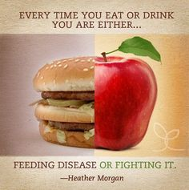
You are what you eat.
Every 28 Days your skin Replaces itself.
Your liver
5 Months.
Your bones,
10 years.
Your Body makes these new cells from the food you eat.
What you EAT literally becomes YOU.

