Slide 1
IMPLEMENTING IPSAS
Possible blind-spots for governments and supreme audit institutions
Bruce Vivian

Slide 2
Implementing ipsas
IPSAS adoption status
Blind-spots in IPSAS implementation
Opportunities for the accounting profession

Slide 3
IPSAS Adoption status

Slide 4
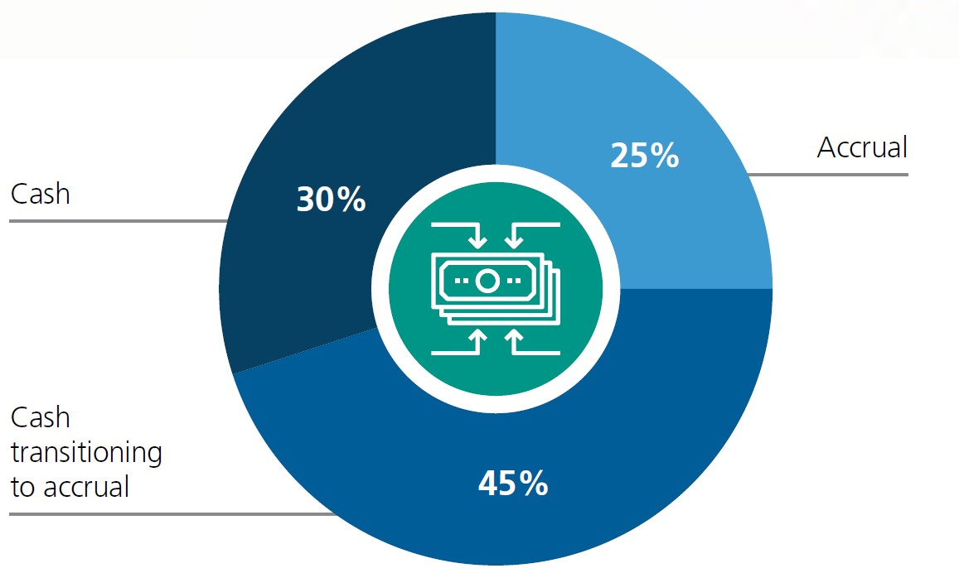
ACCRUAL adoption status
IFAC, CIPFA (2018), International Public Sector Financial Accountability Index, 2018 Status Report

Slide 5
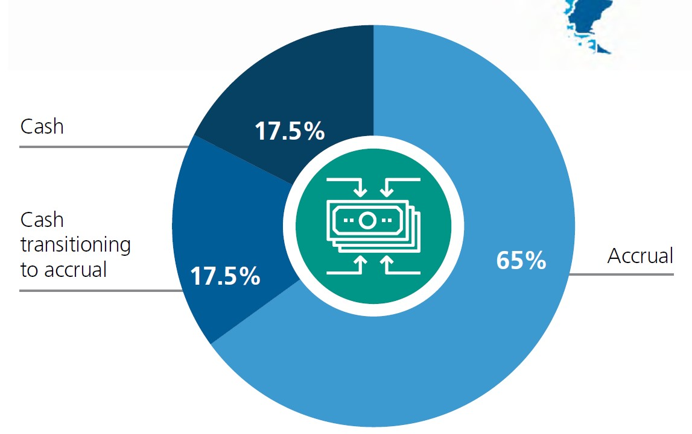
2023 projection
IFAC, CIPFA (2018), International Public Sector Financial Accountability Index, 2018 Status Report

Slide 6
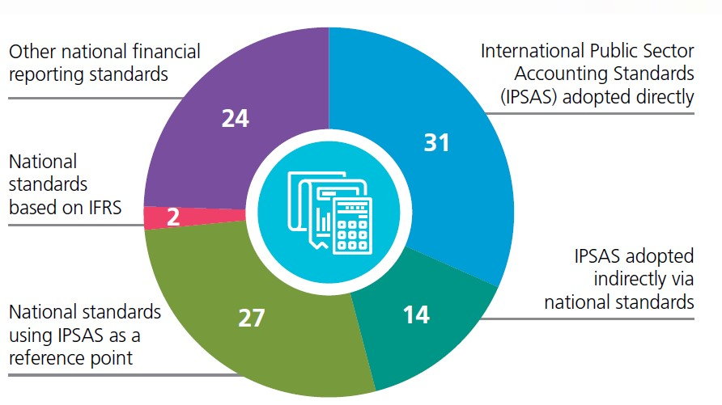
2023 projection (accrual only)
IFAC, CIPFA (2018), International Public Sector Financial Accountability Index, 2018 Status Report

Slide 7
Blind-spots in IPSAS impementation

Slide 8
(1) optimism
Timelines
Off-the-shelf IPSAS
Assuming the benefits

Slide 9
(2) Capacity
Underestimating size of target audience
Focusing only on IPSAS competencies
Over-reliance on consultants

Slide 10
(3) The auditors
Limiting their involvement in migration
Excluding them from capacity building
Focusing only on IPSAS

Slide 11
Opportunities for the profession

Slide 12
Opportunities for the profession
Understand more
Get involved … but not for the money … yet
Market ZICA public sector stream and diploma
Mentor government accountants
Incentivise good reporting

Slide 13
Your public sector needs you!

Slide 14
CONTACT US

Slide 15
https://professionalisation.africa

