Slide 1

ZICA MOBILE APP

Slide 2
INTRODUCTION
The institute obtained Council Approval for development of a mobile App.
The development of the app is aimed at:
1. Enhancing member engagement experience
2. Making it easy for members to acquire information via push notifications
3. Making it easy for students to register, pay and view exam results

Slide 3
FEATURES - LOGIN
The login process has been simplified by employing single sign on.
The app will accept the same login ID that is used on the web member portal
To login a member will require a user ID and password

Slide 4
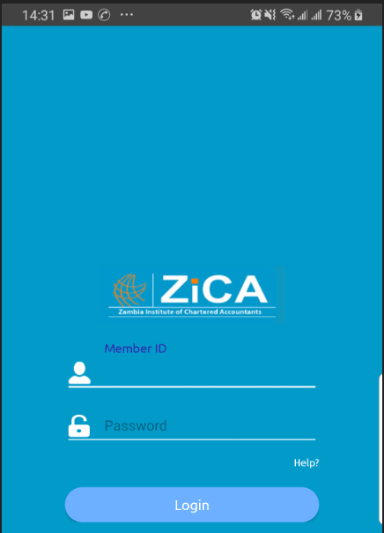
LOGIN SCREEN

Slide 5
FEATURES - MENUS
The app has a number of menus and submenus as follows:
1. News
2. Finance
3. Exam
4. Workshop
5. More

Slide 6
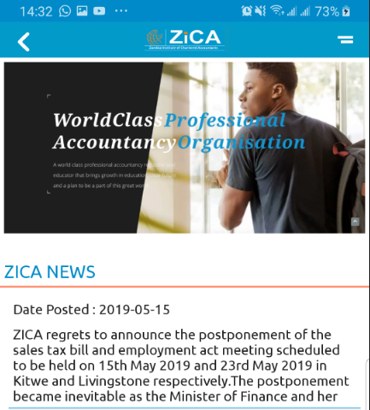
NEWS & NOTIFICATION MENU

Slide 7
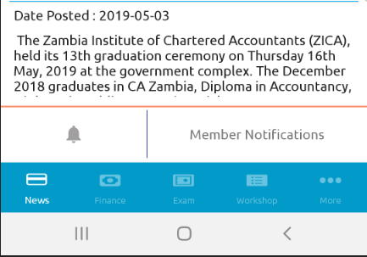
NEWS & NOTIFICATION MENU

Slide 8
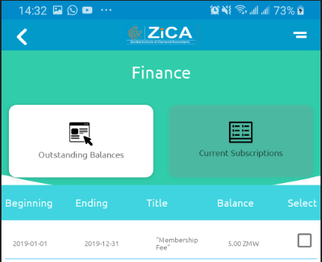
FINANCE MENU

Slide 9
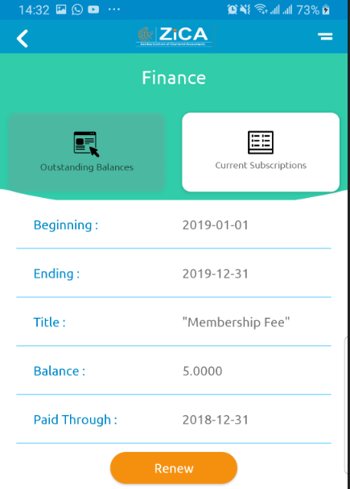
FINANCE MENU

Slide 10
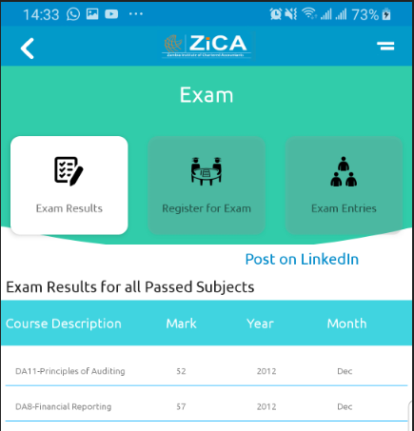
EXAM MENU

Slide 11
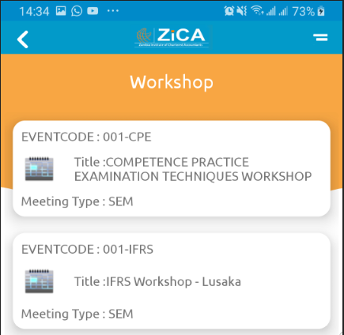
WORKSHOP

Slide 12
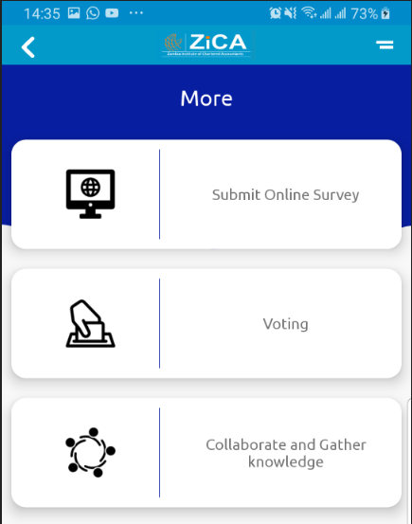
OTHER FEATURES

Slide 13
ROLL OUT
Development of the app is complete
Currently undergoing rigorous user acceptance tests
Application to load app on Apple iOS and Android Play Stores has commenced
App expected to be ready for download by 30th June 2019

